Slide 1
Detailed overview of COVID-19 for Delhi
Prepared by Shreyansh Sharma

Slide 2
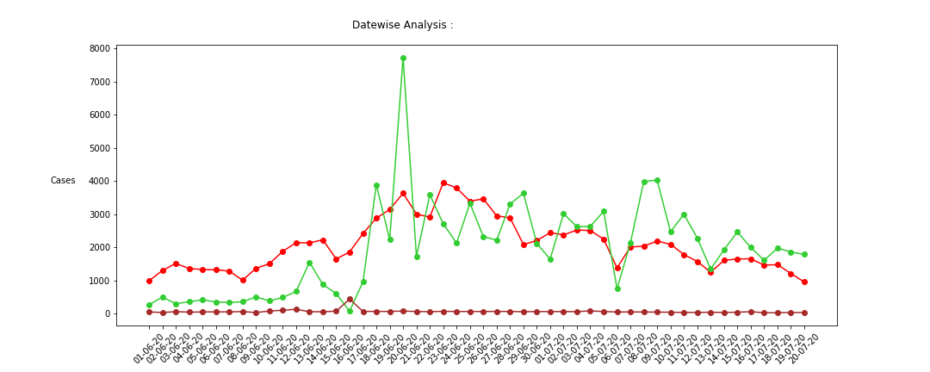
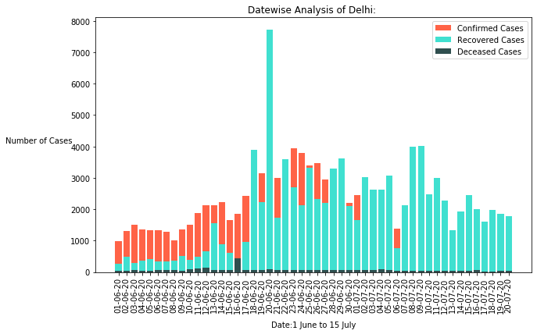
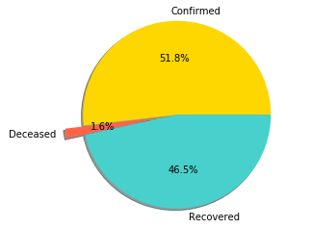
Delhi COVID-19 DASHBOARD for Honourable Chief Minister

Slide 3
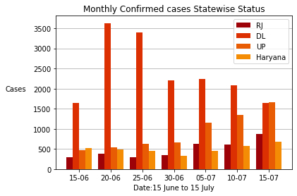
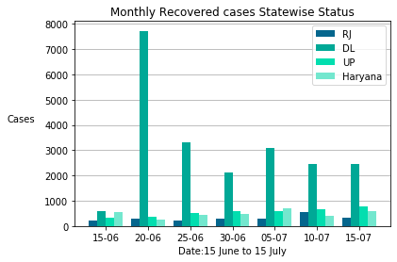
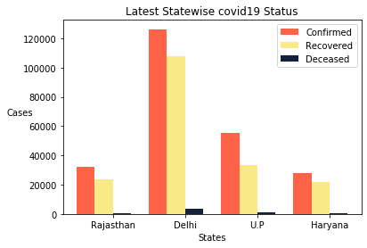
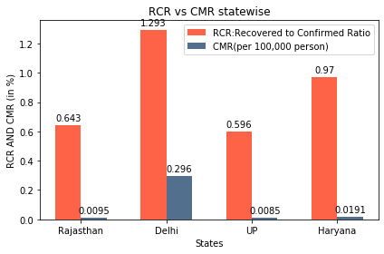
Delhi compared to other States
CMR(Crude Mortality Rate

Slide 4
Thank You!

